Slide 1

Helping users navigate data specifications
Data specification navigator
Quoc Anh Nguyen

Slide 2
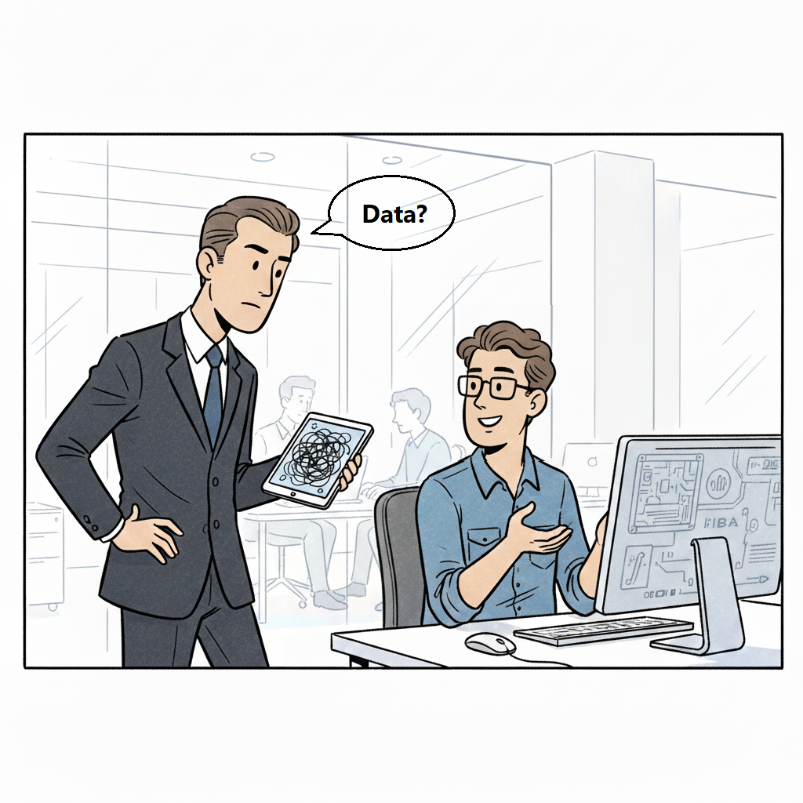

Slide 3
Motivation – the problem
Users want data but don’t know SPARQL or the domain very well.
They rely on a human expert.
This creates a bottleneck in organizations.

Slide 4
Goals
Maps natural-language questions to items in data specification.
Generates SPARQL queries.
Suggests related items to expand queries.

Slide 5
Inputs and outputs
A picture showing the user providing package info, Dataspecer providing DSV.
A picture showing the user sending a message, the app sending message and OWL to LLM, the app returns reply.
A picture showing the user selecting and sending suggestions, the app processes suggestions and asks for more suggestions from the LLM, returns a reply.
Could be 3 separate slides.

Slide 6
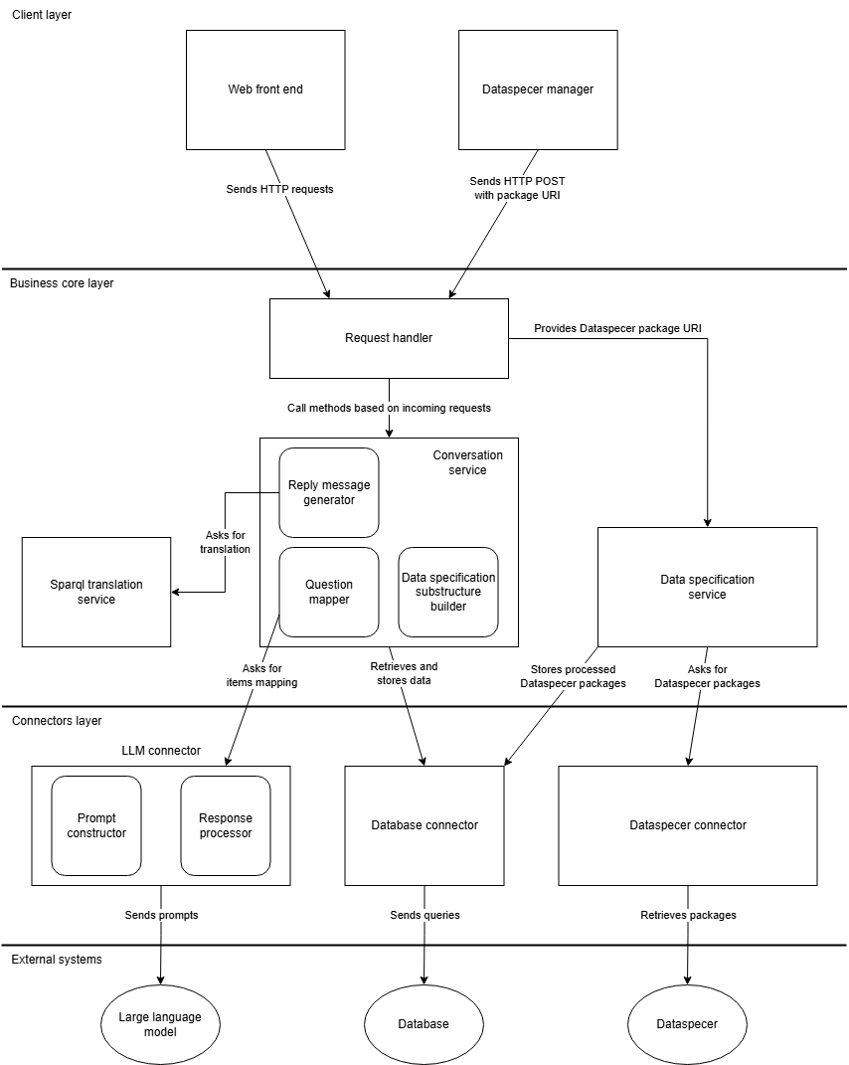
System Architecture

Slide 7





Technologies

Slide 8
Demo
Screenshots

Slide 9
Successfully implemented
DSV to OWL conversion.
Mapping concepts from natural language to data specifications.
SPARQL generation.
Suggestions for natural-language question.
Foundation for future extension and research.

